Slide 1
User Interface Design
Software Design Architecture Lab # 3 Saniya Sarim

Slide 2
User Interface Design
User interface is the front-end application view to which user interacts in order to use the software. User can manipulate and control the software as well as hardware by means of user interface. Today, user interface is found at almost every place where digital technology exists, right from computers, mobile phones, cars, music players, airplanes, ships etc.
User interface is part of software and is designed such a way that it is expected to provide the user insight of the software. UI provides fundamental platform for human-computer interaction.
UI can be graphical, text-based, audio-video based, depending upon the underlying hardware and software combination. UI can be hardware or software or a combination of both.

Slide 3
User Interface Design
The software becomes more popular if its user interface is:
Attractive
Simple to use
Responsive in short time
Clear to understand
Consistent on all interfacing screens

Slide 4
User Interface Design
UI is broadly divided into two categories:
Command Line Interface (Depreciated, Not being used on larger levels)
Graphical User Interface (Desktop Applications, Mobile Applications, Web based Applications …)

Slide 5
User Interface Design
UI is broadly divided into two categories:
Command Line Interface (Depreciated, Not being used on larger levels)
Graphical User Interface (Desktop Applications, Mobile Applications, Web based Applications …)

Slide 6
User Interface Design – Command Line Interface
CLI has been a great tool of interaction with computers until the video display monitors came into existence. CLI is first choice of many technical users and programmers. CLI is minimum interface a software can provide to its users.
CLI provides a command prompt, the place where the user types the command and feeds to the system. The user needs to remember the syntax of command and its use. Earlier CLI were not programmed to handle the user errors effectively.
A command is a text-based reference to set of instructions, which are expected to be executed by the system. There are methods like macros, scripts that make it easy for the user to operate.
CLI uses less amount of computer resource as compared to GUI.

Slide 7
User Interface Design – Command Line Interface
Creating Command line applications
We are using visual studio for creating command line applications called console applications.
Following are Steps
Create new project
Select Console Application and then name that application that you want press enter.
In solution explorer you will now see Program.cs this is the class that contains MAIN method that will execute your program

Slide 8
EXAMPLE STEP BY STEP

Slide 9
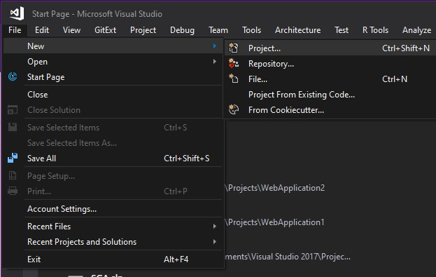
User Interface Design – Command Line Interface
1. Step 1 -> Open visual studio select File and Select New then Select
Project.

Slide 10
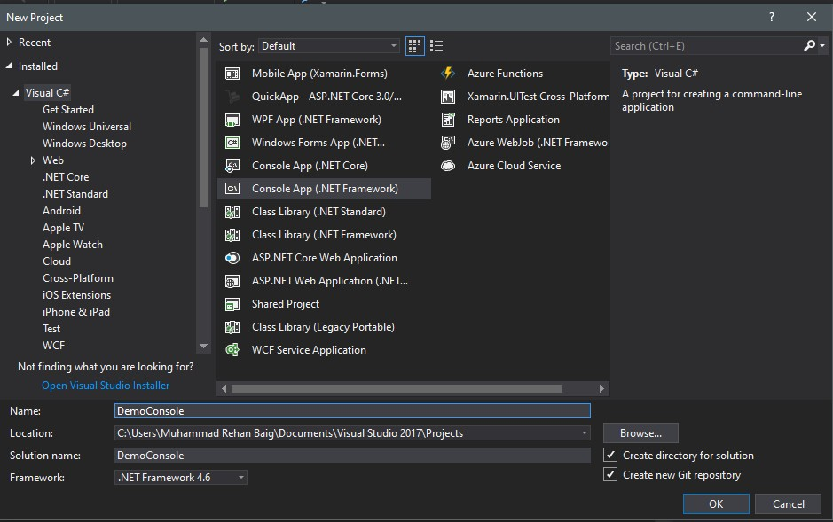
User Interface Design – Command Line Interface
1. Step 2 -> Select Console application and Name your program

Slide 11
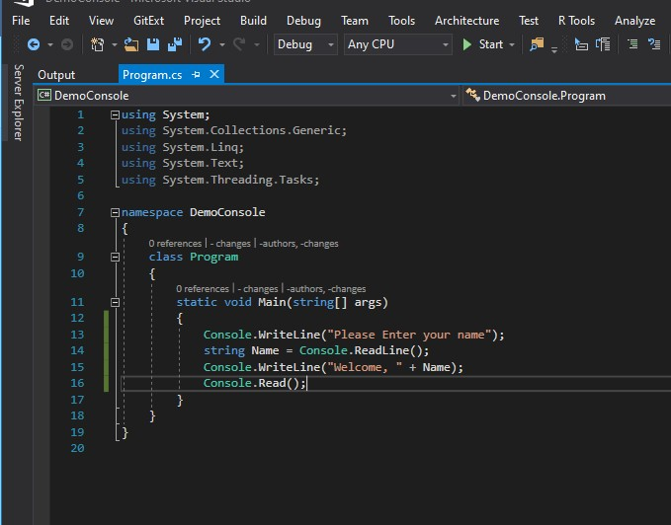
User Interface Design – Command Line Interface
1. Step 3 -> Creating basic project that takes name as an input and welcomes

Slide 12
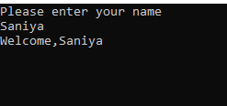
User Interface Design – Command Line Interface
1. Program output

Slide 13
User Interface Design – Graphical User Interface
Graphical User Interface provides the user graphical means to interact with the system. GUI can be combination of both hardware and software. Using GUI, user interprets the software.
GUI provides a set of components to interact with software or hardware.
Almost all interfaces are using GUI for representation of data
It provides easy to use interface and make system more exposable/reachable.

Slide 14
User Interface Design – Graphical User Interface
We in this lab will use visual studio for making graphical user interface as winform project
Step for creating winform are similar as we have done earlier creating a console application.
Just we have to select winform application in templates.

Slide 15
EXAMPLE STEP BY STEP

Slide 16
User Interface Design – Graphical User Interface
1. Step 1 -> Open visual studio select File and Select New then Select
Project.

Slide 17
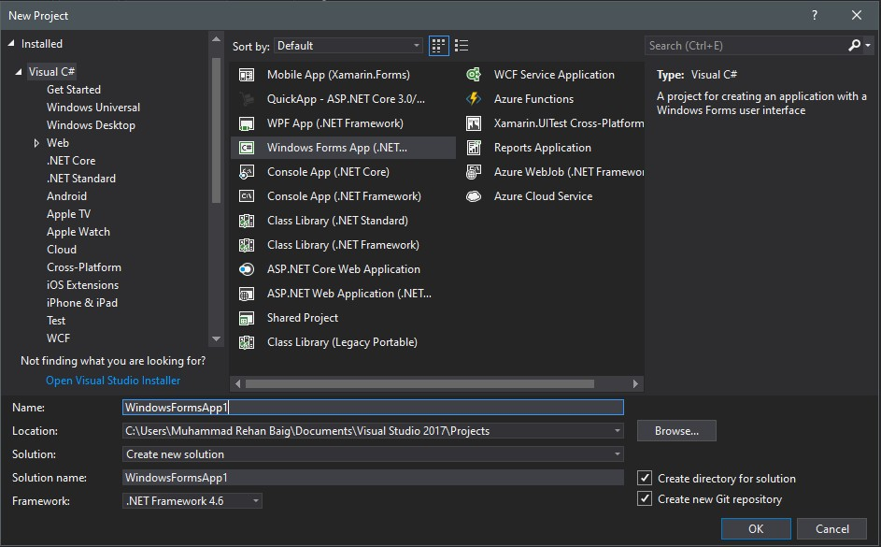
User Interface Design – Graphical User Interface
Step 2 -> Select winform application from template listed

Slide 18
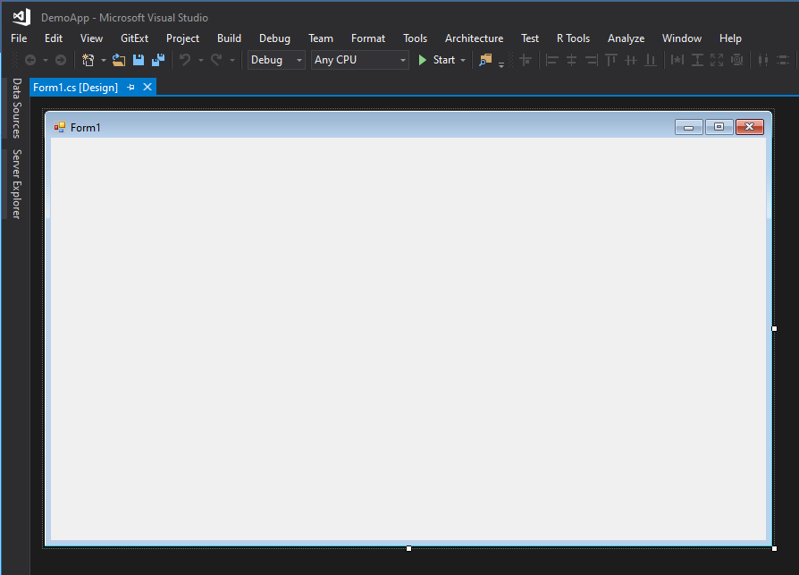
User Interface Design – Graphical User Interface
Step 2 -> Following screen will appear showing UI as a Window

Slide 19
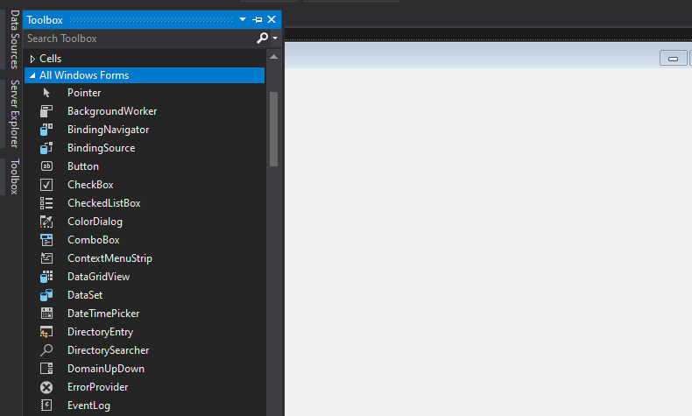
User Interface Design – Graphical User Interface
Step 3 -> Use toolbox for adding controls in form for making UI

Slide 20
User Interface Design – Graphical User Interface
Step 3 -> Use toolbox for adding controls in form for making UI

Slide 21
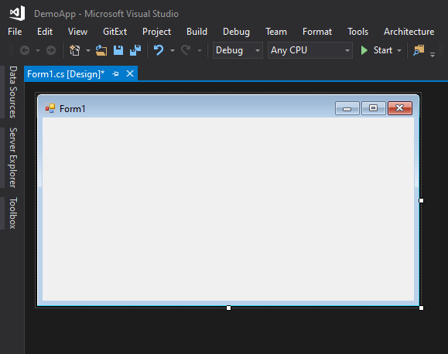
User Interface Design – Graphical User Interface
You can resize form and make it accordingly your requirements

Slide 22
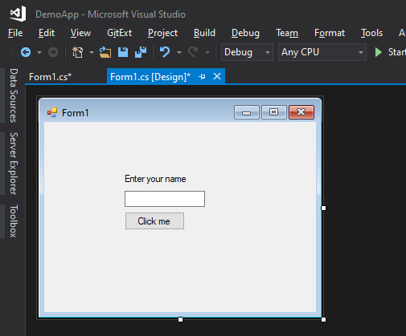
User Interface Design – Graphical User Interface
We are using 3 controls in our form button, textbox and label using toolbox.

Slide 23
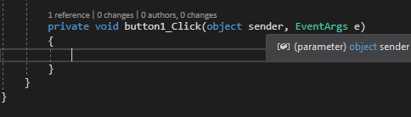
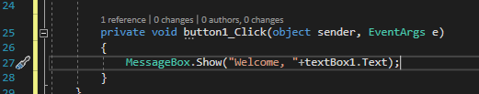
User Interface Design – Graphical User Interface
After double clicking on button it will generate a method that works when we click the button.
In this method we will just show message with the name entered in our textbox that we have added in our winform

Slide 24
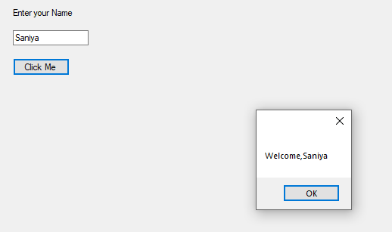
User Interface Design – Graphical User Interface
Output when we run our program and click the button after entering text in it it will generate following dialog.

Slide 25
Tasks
Create basic calculator application on Console Application that perform basic arithmetic operations like(add,subtract,multiply,divide ….)
Create Winform application that authenticate user with hardcoded username and password if user authenticated new form will be open that takes user information as an input and on button click all information will be displayed in dialog box.

